Slide 1
1095-B Business Owner Brief
TUESDAY, AUGUST 16TH, 2022
Notes:
Tracey

Slide 2











Get to know the team
PRODUCT
Business Sponsor
Munish Sikka
Washington DC
Product Lead
Jeanette Cantrell
MO Studio
Program Manager
Tami Corson
North Carolina
Clinical SME / Scrum
Development Team
DESIGN
Tarsha Tremble
Management Analyst, Member Benefits
VHA- Health Enrollment Center
Thomas McCue Oak Park, IL Principal Designer Director
Carl Dickerson Atlanta, GA Content Strategist
Carolyn Williams Chicago, IL Experience Designer
Product Owner
ENGINEERING
Tracey Mulrooney
United States Digital Service
Product Owner
Shashank Khandelwal
Rockville, MD
Tech Lead
Teagan Stephenson
Ft. Lauderdale, FL
Full Stack Engineer
1095-B Product Only
Dan Smith
Charleston, SC
QA Engineer / 508 Specialist
Introduction
Notes:
Munish

Slide 3
Digitized 1095-B tax document
Designs
How it works
Next steps
Approval for release
Opt-in to paperless delivery of 1095-B
How it works
Next steps
Agenda
Agenda
3
Notes:
Munish

Slide 4
1095-B Digitized Form Launch
BUSINESS OWNER BRIEF

Slide 5
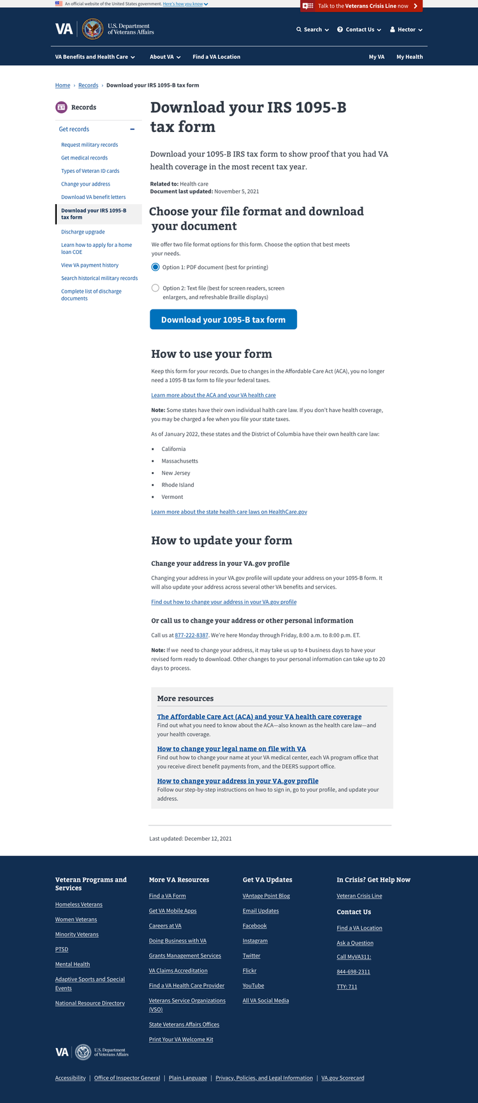
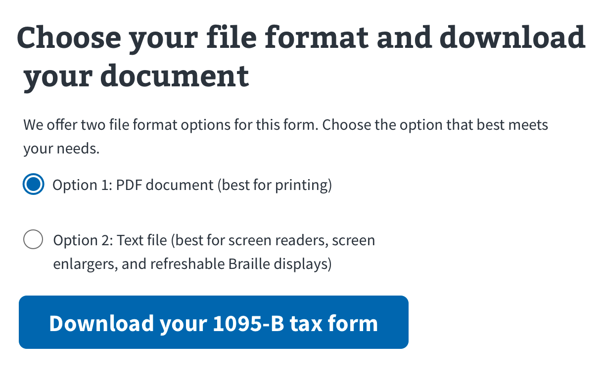
VA.gov web page design
Usability tested with Veterans
Approved by OGC and IRS
Provides PDF or accessible Text file format
Highlights path to digitally update mailing address
Includes Google Analytics reporting
1095-B Prototype
1095-B Webpage designs
Notes:
Carl

Slide 6
Initial launch next steps
Approval from HEC to release: August 16th
Approval from VA.gov for release: August 18th
Release plan
Usability testing with internal and then recruited Veterans
Staggered rollout: 25% then 50%
If any issues arise during rollout, a feature flag has been built which will immediately remove the form from production
Go live to all Veterans: September 6th
Notes:
Munish

Slide 7
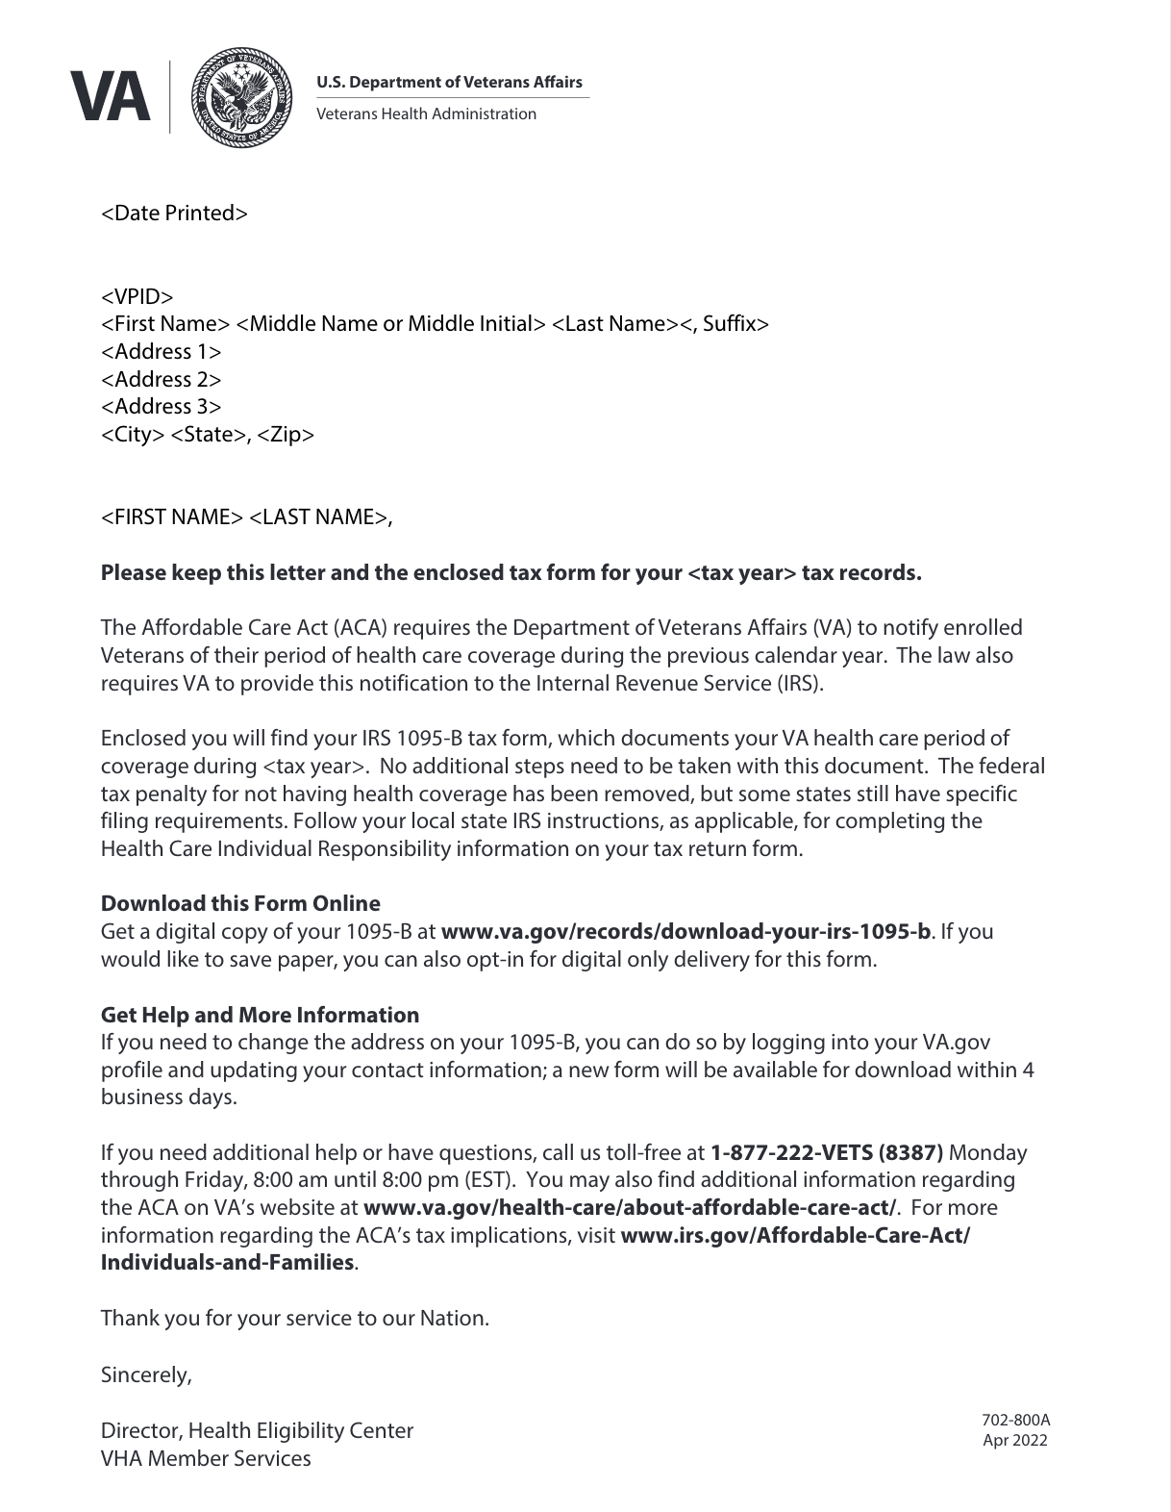

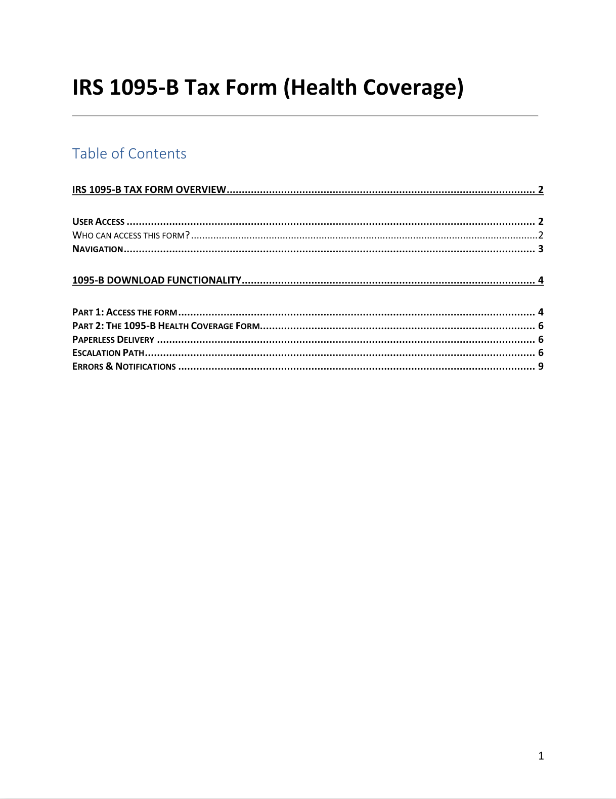
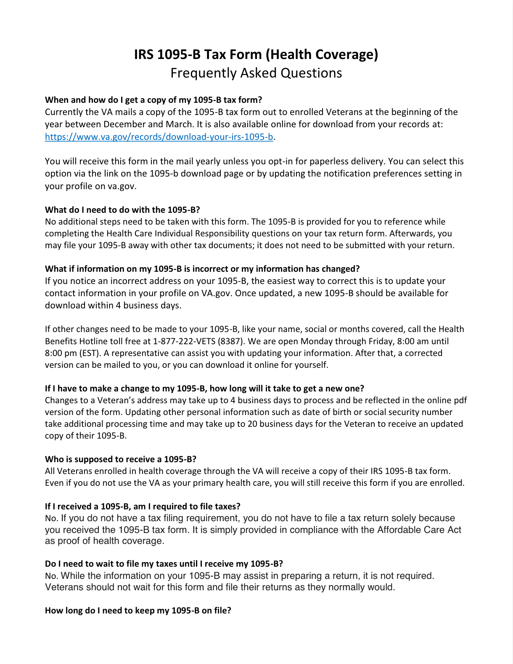
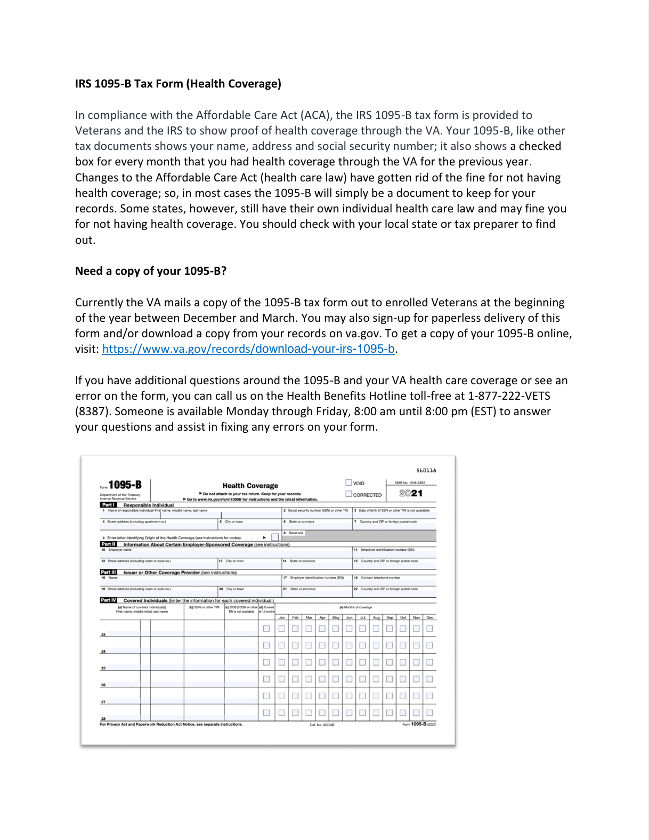
Spanish translation for 1095-B documents
Documents to be translated:
SOW Web Content Contract
HEC Fact Sheet
HEC User Guide
1095-B Landing Page
HEC FAQ
Cover Letter (for mail)
Fast-follow after launch of 1095-B page
Notes:
Carl

Slide 8
Questions?
Notes:
Munish

Slide 9


Approval for digitized 1095-B launch?
Notes:
Munish

Slide 10
Opt-in to Paperless Delivery of 1095-B
BUSINESS OWNER BRIEF

Slide 11
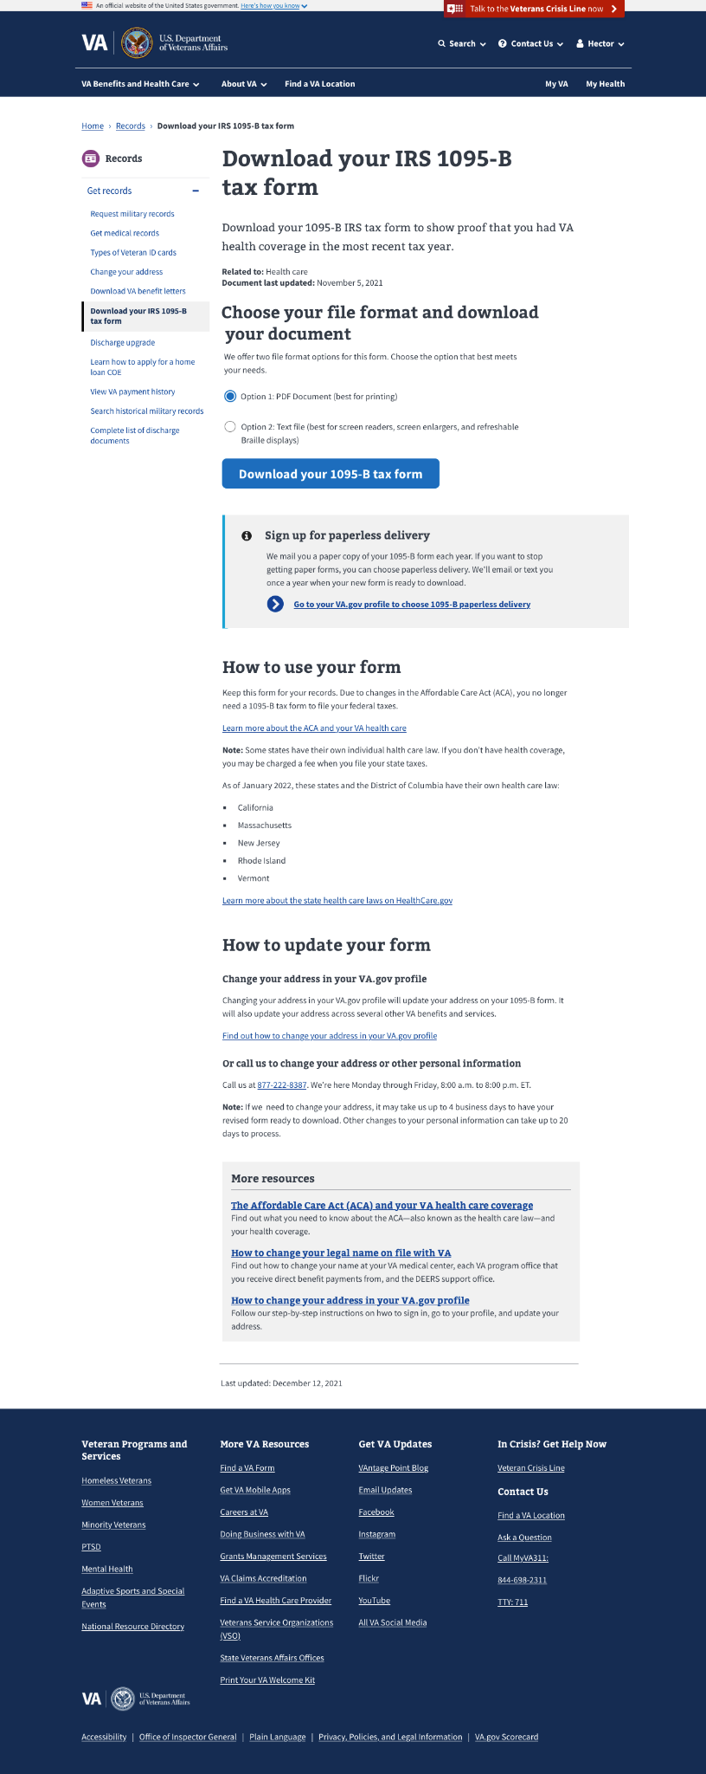

Paperless delivery
IRS approved method of delivery
1095-B page will direct Veterans to sign up for paperless delivery
Veterans may choose paperless delivery in their VA.gov profile
Delivery preference will be stored in VA.gov Profile then shared with HEC’s Enrollment System to omit those forms from printing
1095-B Post-MVP
Notes:
Carl

Slide 12
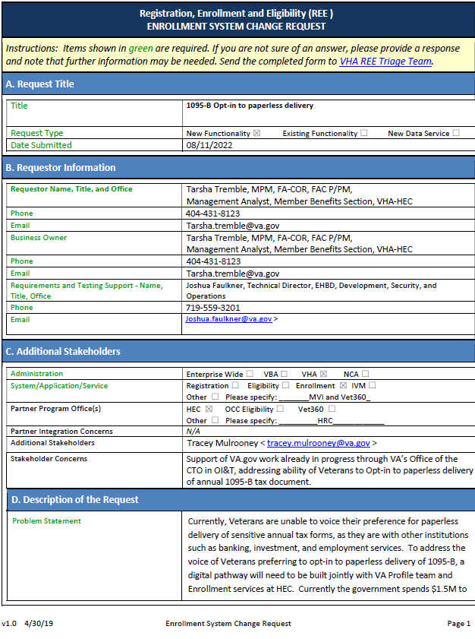
Paperless delivery next steps
Prioritization from HEC for development to begin for the November Enrollment System release
Once ES begins work, VA Profile and My VA will begin their work to align on a 2022 release.
Approval from Legal, HEC and VA.gov for release
Notes:
Munish

Slide 13
Questions?
Notes:
Jeanette

Slide 14
Appendix
BUSINESS OWNER BRIEF

Slide 15
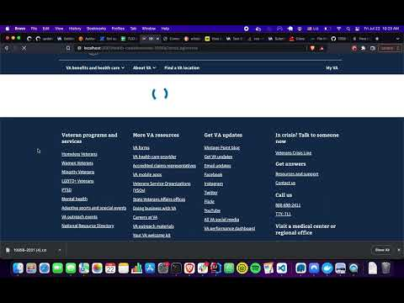
How it works
Link to video, “How it works.”
Notes:
Carl

Slide 16
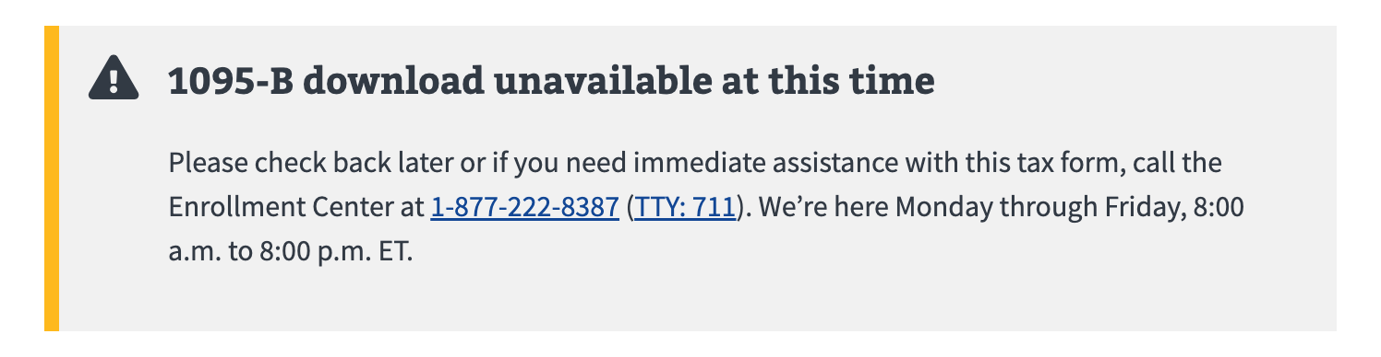
Incident response plan
Link
Notes:
Carl

